Slide 1
Competitive Programming
04 Nov. 2022
Andrei Novikov

Slide 2
Revise Homework - Overview
Book: “Competitive Programming 3”.
Tasks:
- UVa 00908 – Re-connecting Computer Sites (Link)
UVa 01174 – IP-TV (Link)
UVa 01208 – Oreon (Link)

Slide 3
Revise Homework
UVa 00908 – Re-connecting Computer Sites (Link)
Solution: Link
Disjoint Set (set operations)
Compare cost to connect computers sites after renovation with the cost that was before.
Kruskal’s Algorithm (MST)

Slide 4
Revise Homework
UVa 01174 - IP-TV: Link
Solution: Link
Optimize cost for broadcasting.
Hash Map (names <-> indexes)
Disjoint Set (set operations)
Kruskal’s Algorithm (MST)

Slide 5
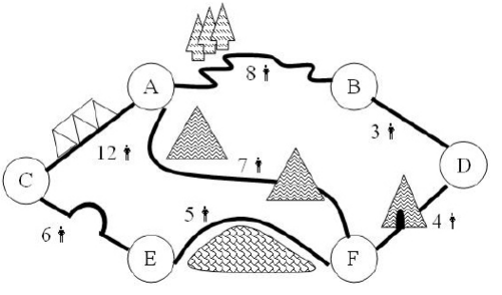
Revise Homework
UVa 01208 - Oreon: Link
Solution: Link
Find minimum number of soldiers to protect tunnels and print out orders.
Disjoint Set (set operations)
Kruskal’s Algorithm (MST) to build graph

Slide 6
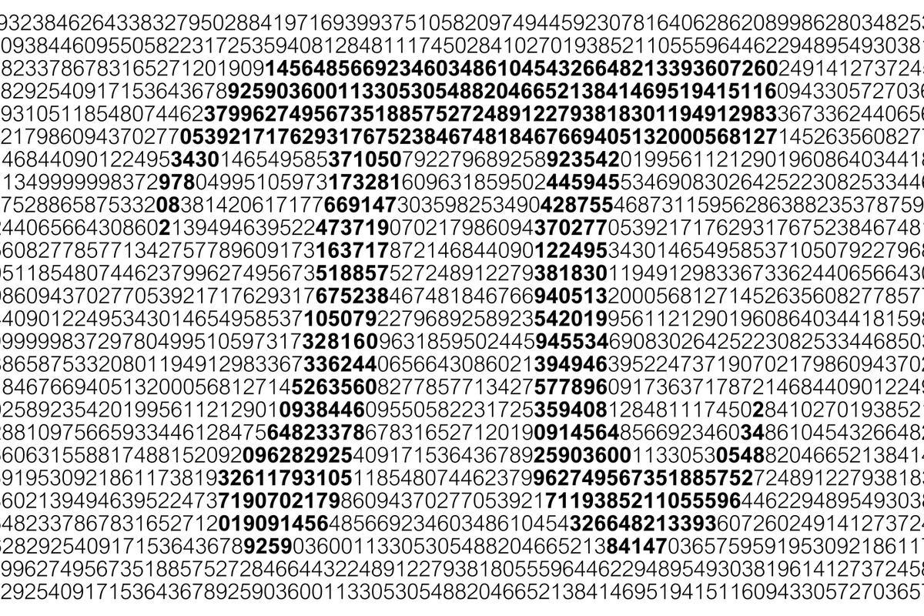
Quiz
How to calculate pi (3.14) using only random() function that generates numbers in range [0; 1]?

Slide 7
Quiz - Probability
Probability is defined as
P(A) = m / n = [favorable outcomes] / [possible outcomes]

Slide 8
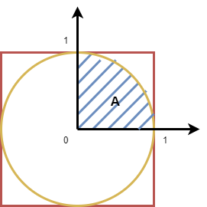
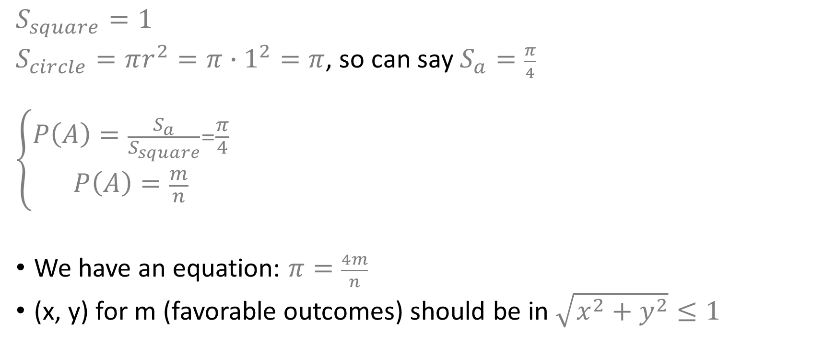
Quiz – Geometrical Model
$$S_{square}=1$$
$S_{circle}=πr^{2}=π∙1^{2}=π$, so can say$S_{a}=\frac{π}{4}$
$$\left\{\begin{aligned}P\left(A\right)=\frac{S_{a}}{S_{square}}=\frac{π}{4} \\ P\left(A\right)=\frac{m}{n}\end{aligned}\right.$$
We have an equation: $π=\frac{4m}{n}$
(x, y) for m (favorable outcomes) should be in $\sqrt{x^{2}+y^{2}}≤1$

Slide 9
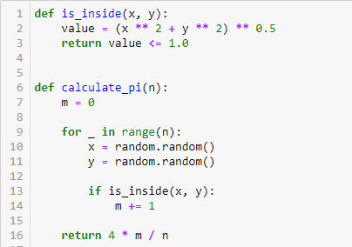

Quiz – Solution
We have an equation: $π=\frac{4m}{n}$
(x, y) for m (favorable outcomes) should be in $\sqrt{x^{2}+y^{2}}≤1$

Slide 10
Life Practice – Challenge #1
Topic: Greedy Algorithm
Resource: Leetcode
179 Largest Number - Link

Slide 11
Life Practice – Challenge #1
Topic: Greedy Algorithm
Resource: Leetcode
1584 Min Cost to Connect All Points - Link

Slide 12
Home task
Problems from Benelux Algorithm Programming Contest (BAPC) preliminaries 2016

Slide 13




Where to Practice
LeetCode [link]
HackerRank [link]
Kattis [link]
TopCoder [link]
Other Resources

